Slide 1



Enterprise Programming (303105309)
Prof. Rina kumari, Assistant Professor Computer Science & Engineering

Slide 2
JDBC And Architecture of JDBC

Slide 3





































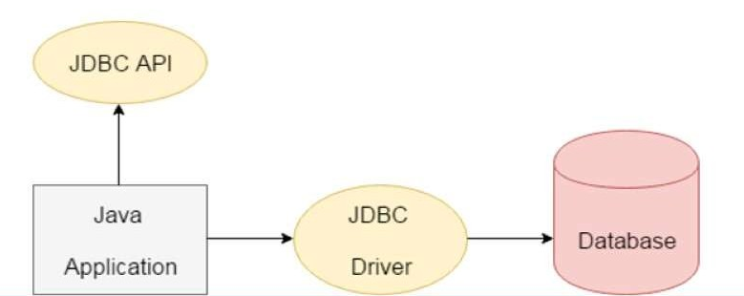







Introduction to JDBC (Java Database Connectivity)
JDBC is a Java API to connect and execute the query with the database.
It is a specification from Sun Microsystems that provides an abstraction (API or Protocol) for Java applications to communicate with various databases such as Oracle, MS Access, Mysql, SQL server database, and many more.
It provides the language with Java database connectivity standards.
JDBC and database drivers work in tandem to access spreadsheets and databases.

Slide 4
Why Should We Use JDBC
Before JDBC, ODBC API was the database API to connect and execute the query with the database. But, ODBC API uses ODBC driver which is written in C language (i.e. platform dependent and unsecured). That is why Java has defined its own API (JDBC API) that uses JDBC drivers (written in Java language).
We can use JDBC API to handle database using Java program and can perform the following activities:
Connect to the database
Execute queries and update statements to the database
Retrieve the result received from the database.

Slide 5
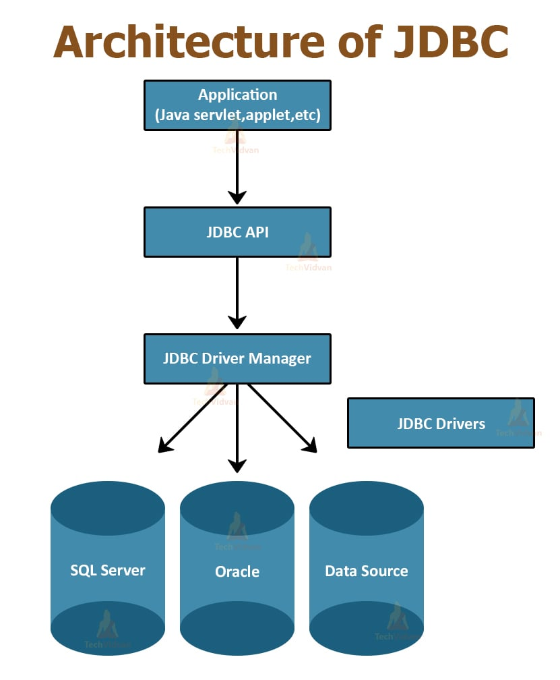
Components of JDBC

Slide 6
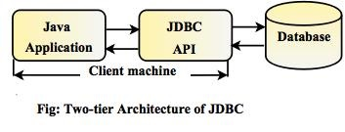
Different Types of Architecture of JDBC
The architecture of the JDBC consists of two and three tiers model in order to access the given database.
Two-tier model: A java application communicates directly to the data source. The JDBC driver enables the communication between the application and the data source. When a user sends a query to the data source, the answers for those queries are sent back to the user in the form of results. The data source can be located on a different machine on a network to which a user is connected. This is known as a client/server configuration, where the user’s machine acts as a client, and the machine has the data source running acts as the server.

Slide 7
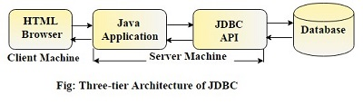
Different Types of Architecture of JDBC
2.Three-tier model: In this, the user’s queries are sent to middle-tier services, from which the commands are again sent to the data source. The results are sent back to the middle tier, and from there to the user. This type of model is found very useful by management information system directors.

Slide 8
JDBC Drivers

Slide 9
JDBC Drivers
JDBC drivers are client-side adapters (installed on the client machine, not on the server) that convert requests from Java programs to a protocol that the database can understand.
There are 4 types of JDBC drivers:
Type-1 driver or JDBC-ODBC bridge driver
Type-2 driver or Native-API driver
Type-3 driver or Network Protocol driver
Type-4 driver or Thin driver

Slide 10






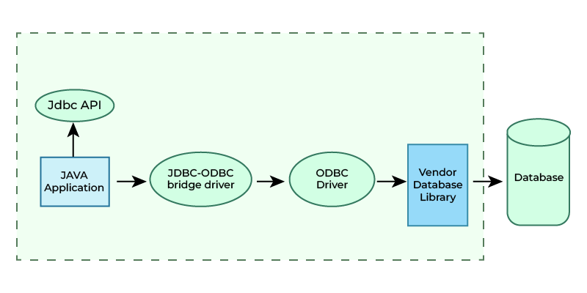





JDBC Drivers
Type-1 driver or JDBC-ODBC bridge driver
It is an ODBC driver to connect with different databases.
It converts JDBC method calls into ODBC function calls.
It is a database-independent driver.
No need to install it separately as built-in with JDK.

Slide 11
JDBC Drivers
Advantages:
Built-in with JDK (no separate installation required).
Database-independent.
Disadvantages:
Data transferred through this driver is not very secure.
Requires ODBC bridge driver installation on individual client machines.
Not written in Java, so it isn’t portable

Slide 12
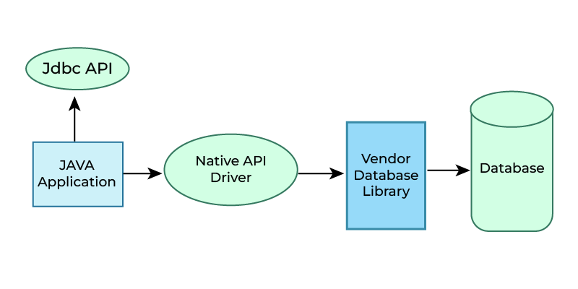
JDBC Drivers
Type-2 driver or Native-API driver
It uses the client-side database libraries of the database for connectivity.
It converts JDBC method calls into the native call of the database API.
It needs their local API, for that data transfer is more secure as compared to Type-1.
It needs to be installed individually for each client machine.

Slide 13
JDBC Drivers
Advantages:
Better performance than the JDBC-ODBC bridge driver.
More secure data transfer.
Disadvantages:
Requires separate installation on client machines.
Vendor client library must be installed on the client machine.
Not fully written in Java (partially Java driver)

Slide 14
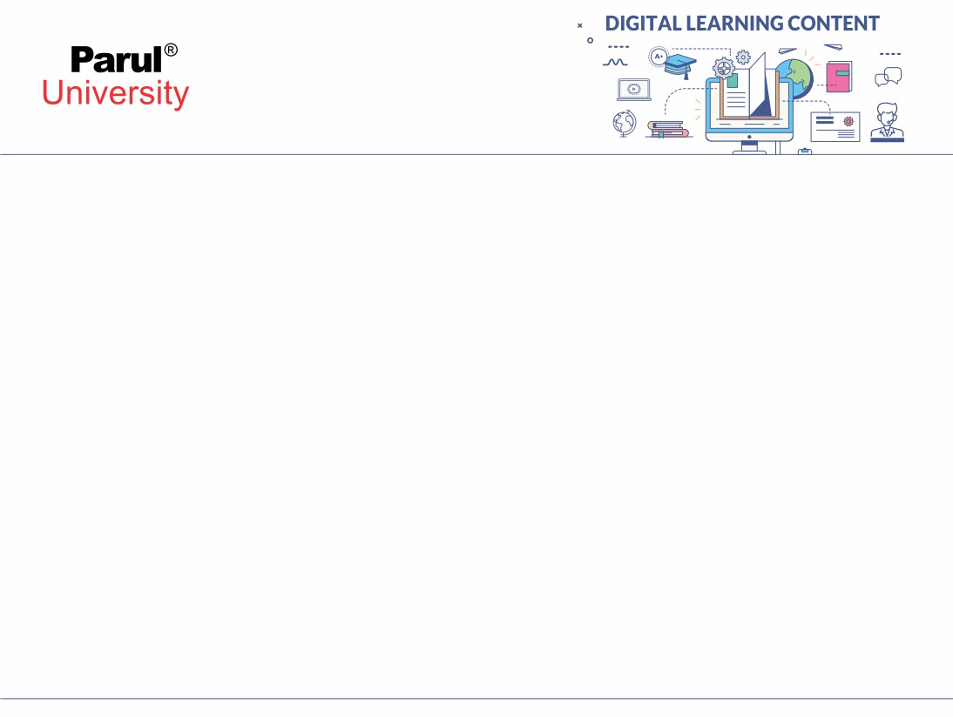
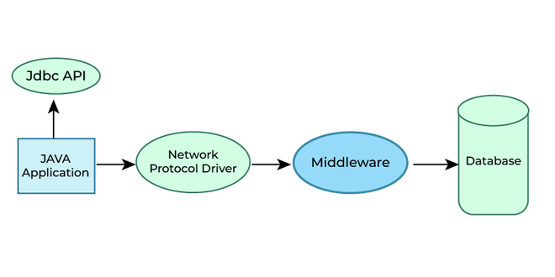
JDBC Drivers
Type-3 driver or Network Protocol driver
It uses middleware ( application server ) that converts JDBC calls into vendor-specific database protocol.
Drivers are present in a single server.
It is a portable driver because fully written in Java.
No client-side library is required because of application server can perform many tasks like auditing, load balancing, logging etc.
Maintenance of Network Protocol driver becomes costly

Slide 15
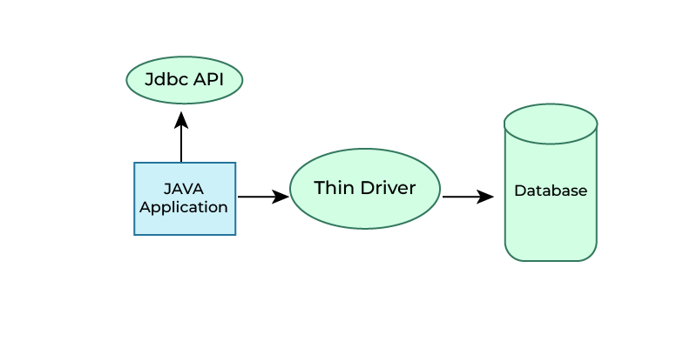
JDBC Drivers
Type-4 driver or Thin driver
It is also called a native protocol driver.
It does not require any native database library, that is why it is also known as Thin Driver.
It is a portable driver because fully written in java.

Slide 16
JDBC Drivers
Advantages:
High performance.
Secure data transfer.
Portable (written entirely in Java).

Slide 17
Which Driver to Use When?
If you are accessing one type of database, such as Oracle, Sybase, or IBM, the preferred driver type is type-4.
If your Java application is accessing multiple types of databases at the same time, type 3 is the preferred driver.
Type 2 drivers are useful in situations, where a type 3 or type 4 driver is not available yet for your database.
The type 1 driver is not considered a deployment-level driver and is typically used for development and testing purposes only.

Slide 18
Interfaces of JDBC API Classes of JDBC API
Driver interface
Connection interface
Statement interface
Prepared Statement interface
Callable statement interface
Result Set interface
Result Set MetaData interface
Database MetaData interface
Rowset interface
Driver Manager class
Blob class
Clob class
Types class

Slide 19
Class forName() method
This forName() method of java.lang.Class class is used to get the instance of this class with the specified class name.
This class name is specified as the string parameter.
Syntax
Public static Class<T> forName(String className) throws
ClassNotFoundException
Example
class.forName(“com.mysql.cj.jdbc.Driver”) -> For MySql Connectivity
class.forName(“oracle.jdbc.driver.OracleDriver”) -> For Oracle connectivity

Slide 20
Driver Manager
The DriverManager class is the main component of JDBC API.
The DriverManager class acts as an interface between users and drivers.
It keeps track of the drivers that are available and handles establishing a connection between a database and the appropriate driver.
It also contains all the appropriate methods to register and deregister the database driver class and to create a connection between a Java application and the database.
Methods:
public static void registerDriver(Driver driver)
public static void deregisterDriver(Driver driver)
public static Connection getConnection(String Url)
public static Connection getConnection(String Url, String username, String password)
Example
String connectionUrl = “jdbc:mysq|://localhost:3307/dbname”
Connection conn = DriverManager.getConnection(connectionUrl, "root", "password");

Slide 21
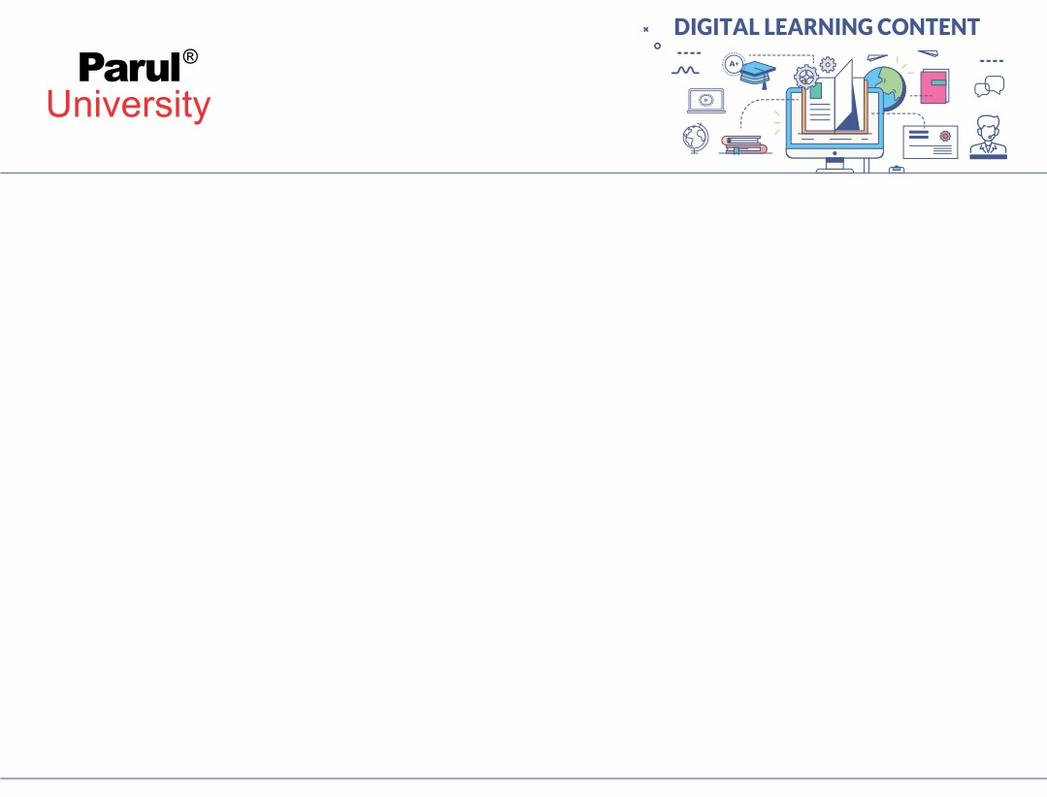

Connection Interface
Connection interface is used for creating the session between the application and the database.
This interface contains Statement, PreparedStatement and DatabaseMetaData.
Methods
public Statement createStatement()
public Statement createStatement(int resultSetType,int resultSetConcurrency)
public void setAutoCommit(boolean status)
public void commit()
public void rollback()
public void close()

Slide 22
Statement Interface
The Statement interface is used for executing queries using the database. This interface is a factory of ResultSet.
It is used to get the Object of ResultSet.
Methods
public ResultSet executeQuery(String sql)
public int executeUpdate(String sql)
public boolean execute(String sql)
public int[] executeBatch()
Example
Statement stmt = conn.createStatement();
ResultSet result = stmt.executeQuery(“Select * From students”);

Slide 23
ResultSet Interface
The ResultSet Interface is used for maintaining the pointer to a row of a table. Initially, cursor points to before the first row.
The object can be moved forward as well as backward direction using TYPE _SCROLL_INSENSITIVE or TYPE _SCROLL_SENSITIVE in createStatement(int,int).
TYPE _SCROLL_INSENSITIVE - Changes done in the database are not reflected in the ResultSet.
TYPE _SCROLL_SENSITIVE - Changes done in the database are reflected in the Resultset.
CONCUR_UPDATABLE -— This type of result set is updatable.
CONCUR_ READONLY - This type of result set is not updatable
For Example
Statement stmt = con.createStatement(ResultSet. TYPE _SCROLL_INSENSITIVE, ResultSet.CONCUR_UPDATABLE);
Example
ResultSet result = stmt.executeQuery(“Select * From students”);

Slide 24
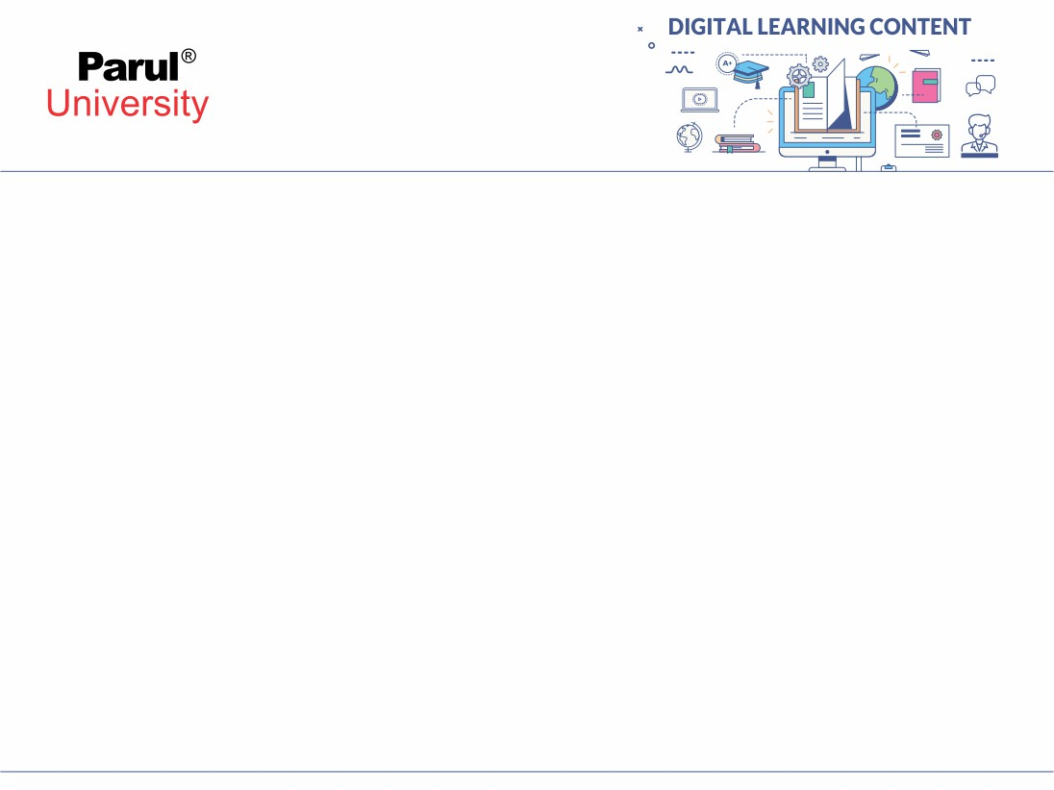
Example
try {
Class. forName("com.mysql.cj.jdbc.Driver") ;
conn =DriverManager.getConnection("jdbc:mysql://localhost:3306/myData","root", "pwd" ) ;
Statement stmt = conn.createStatement();
ResultSet result = stmt.executeQuery(“select * from employees”);
while(result.next()) {
System.out.println(result.getInt(1) + "\t" + result.getString(2) +" "+ pesult.getString(3));
}
conn.close();
}
catch (Exception e) {
System.out.println("my Error :" + e.getMessage());
}

Slide 25
PreparedStatement Interface
PreparedStatement interface is a subinterface of Statement.
It is mainly used for the parameterized queries. A question mark (?) is passed for the values.
The values to this question marks will be set by the PreparedStatement.
Example
PreparedStatement stmt = conn.prepareStatement(“insert into Employees values(?,?, ?)”);
stmt.setint(1, 1001)
stmt.setString(2, “Mahesh”)
stmt.setint(3, “Shah”)
int result = stmt.executeUpdate();

Slide 26
ResultSetMetaData Interface
ResultSetMetaData interface is used to get metadata from the ResultSet object.
Metadata are the data about data.
Methods
public int getColumnCount() throws SQLException
public String getColumnName(int index) throws SQLException
public String getColumnTypeName(int index) throws SQLException
public String getTableName(int index) throws SQLException
Example
ResultSetMetaData resmd = result.getMetaData();
System.out.printIn("Total columns: “ + resmd.getColumnCount());
System.out.printIn("Column Name of 1st column: “ + resmd.getColumnName(1));
System.out.printIn("Column Type Name of ist column: “ +resmd.getColumnTypeName(1));

Slide 27
DatabaseMetaData interface provides methods to get meta data of a database suchas database product name, database product version, driver name, name of totalnumber of tables, name of total number of views etc. Methods public String getDriverName() throws SQLException public String getDriverVersion() throws SQLException public String getUserName() throws SQLException public String getDatabaseProductName() throws SQLException public String getDatabaseProductVersion() throws SQLException public ResultSet getTables(String catalog, String schemaPattern, String tableNamePattern,String[] types) throws SQLException
DatabaseMetaData Interface

Slide 28
Example
DatabaseMetaData dbmd=con.getMetaData();
System.out.printiIn("Driver Name: "+dbmd.getDriverName());
System.out.printIn("Driver Version: "+dbmd.getDriverVersion());
System.out.printiIn("“UserName: "+dbmd.getUserName());
System.out.printIn("Database Product Name: "+dbmd.get DatabaseProduct Name());
System.out.printIn("Database Product Version: "+dbmd.getDatabase Product Version());

Slide 29
RowSet Interface
AJDBC RowSet facilitates a mechanism to keep the data in tabular form.
It is the wrapper of ResultSet.
AJDBC RowSet object holds tabular data in a style that makes it more adaptable andsimpler to use than a result set.
The implementation classes of the RowSet interface are as follows:
1. JdbcRowSet
2. CachedRowSet
3. WebRowSet
4. JoinRowSet
5. FilteredRowSet

Slide 30
JdbcRowSet
It basically acts as a wrapper around the ResultSet object with some additionalfunctionality.
It is only connected RowSet in the family.
The primary advantage of using JdbcRowSet is that it enables the ResultSet object tobe used as a JavaBeans component.
It is scrollable and updatable capabilities to the ResultSet object.

Slide 31
CachedRowSet
CachedRowSet object is unique because it can operate without being connected toits data source. We call this a “disconnected RowSet object”.
it caches its data in memory so that it can operate on its own data instead of thedata stored in a database.

Slide 32
WebRowSet
It extends CachedRowSet capabilities but is very special in the sense that in additionto providing all the features of CachedRowSet, it can read and write XML document.
it can write itself to an XML document and can also read that XML document toconvert itself back to a WebRowSet.
it is mainly used in enterprise application scenario or in web service communication.

Slide 33
FilteredRowSet
It is Jonrowe an extension of WebRowSet.
filtering data based on criteria to fetch selected rows from the data source so that we can work with the relevant data.
It is something like using the WHERE clause without writing an SQL.
Image source : Google

Slide 34
JoinRowSet Interface
It provides capabilities of WebRowSet and CachedRowSet, we can perform a SQL JOIN operation without connecting to a data source.
It enables us to create SQL JOIN between RowSet objects and Related records from different RowSets can be combined to form this RowSet object.

Slide 35
Jdbc with Oracle
Java Database Connectivity with 5 Steps
There are 5 steps to connect any java application with the database using JDBC. These steps are as follows:
Register the Driver class
Create connection
Create statement
Execute queries
Close connection

Slide 36
1) Register the driver class
The forName() method of Class class is used to register the driver class. This method is used to dynamically load the driver class. Syntax of forName() method public static void forName(String className)throws ClassNotFoundException Example to register the OracleDriver class Here, Java program is loading oracle driver to esteblish database connection. Class.forName("oracle.jdbc.driver.OracleDriver");

Slide 37
2) Create the connection object
The getConnection() method of DriverManager class is used to establish connection with the database. Syntax of getConnection() method 1) public static Connection getConnection(String url)throws SQLException 2) public static Connection getConnection(String url,String name,String password) throws SQLException Example to establish connection with the Oracle database Connection con=DriverManager.getConnection( "jdbc:oracle:thin:@localhost:1521:xe","system","password");

Slide 38
3) Create the Statement object
The createStatement() method of Connection interface is used to create statement. The object of statement is responsible to execute queries with the database. Syntax of createStatement() method public Statement createStatement()throws SQLException Example to create the statement object Statement stmt=con.createStatement();

Slide 39
4) Execute the query
The executeQuery() method of Statement interface is used to execute queries to the database. This method returns the object of ResultSet that can be used to get all the records of a table. Syntax of executeQuery() method public ResultSet executeQuery(String sql)throws SQLException Example to execute query ResultSet rs=stmt.executeQuery("select * from emp"); while(rs.next()){ System.out.println(rs.getInt(1)+" "+rs.getString(2)); }

Slide 40
5) Close the connection object
By closing connection object statement and ResultSet will be closed automatically. The close() method of Connection interface is used to close the connection. Syntax of close() method public void close()throws SQLException Example to close connection con.close();

Slide 41
JDBC with Oracle and Mysql

Slide 42
Java Database Connectivity with Oracle
To connect java application with the oracle database, we need to follow 5 following steps. In this example, we are using Oracle 10g as the database. So we need to know following information for the oracle database:
Driver class: The driver class for the oracle database is oracle.jdbc.driver.OracleDriver.
Connection URL: The connection URL for the oracle10G database is jdbc:oracle:thin:@localhost:1521:xe where jdbc is the API, oracle is the database, thin is the driver, localhost is the server name on which oracle is running, we may also use IP address, 1521 is the port number and XE is the Oracle service name. You may get all these information from the tnsnames.ora file.
Username: The default username for the oracle database is system.
Password: It is the password given by the user at the time of installing the oracle database.

Slide 43
Java Database Connectivity with Oracle
Create a Table
Before establishing connection, let's first create a table in oracle database. Following is the SQL query to create a table.
create table emp(id number(10),name varchar2(40),age number(3));
Example to Connect Java Application with Oracle database
In this example, we are connecting to an Oracle database and getting data from emp table. Here, system and oracle are the username and password of the Oracle database.

Slide 44
Example to Connect Java Application with Oracle database
import java.sql.*;
class OracleCon{
public static void main(String args[]){
try{
//step1 load the driver class
Class.forName("oracle.jdbc.driver.OracleDriver");
//step2 create the connection object
Connection con=DriverManager.getConnection(
"jdbc:oracle:thin:@localhost:1521:xe","system","oracle");
//step3 create the statement object
Statement stmt=con.createStatement();
//step4 execute query
ResultSet rs=stmt.executeQuery("select * from emp");
while(rs.next())
System.out.println(rs.getInt(1)+" "+rs.getString(2)+" "+rs.getString(3));
//step5 close the connection object
con.close();
}
catch(Exception e){ System.out.println(e);}
}
}

Slide 45
Example to Connect Java Application with MySQL database
Driver class: The driver class for the mysql database is com.mysql.jdbc.Driver.
Connection URL: The connection URL for the mysql database is jdbc:mysql://localhost:3306/sonoo where jdbc is the API, mysql is the database, localhost is the server name on which mysql is running, we may also use IP address, 3306 is the port number and sonoo is the database name. we may use any database, in such case, we need to replace the sonoo with our database name.
Username: The default username for the mysql database is root.
Password: It is the password given by the user at the time of installing the mysql database.

Slide 46
Example to Connect Java Application with MySQL database
import java.sql.*;
class MysqlCon{
public static void main(String args[]){
try{
Class.forName(“com.mysql.jdbc.Driver");
Connection con=DriverManager.getConnection(
“jdbc:mysql://localhost:3306/sonoo”,”root“,”root”);
//here sonoo is databse name, root is username and password
Statement stmt=con.createStatement();
ResultSet rs=stmt.executeQuery("select * from emp");
while(rs.next())
System.out.println(rs.getInt(1)+" "+rs.getString(2)+" "+rs.getString(3));
con.close();
}
catch(Exception e){ System.out.println(e);
}
}
}

Slide 47
Maven Integration with Eclipse

Slide 48
What is Maven?
Definition: Maven is a build automation and project management tool for Java projects.
It simplifies the process of building, testing, and deploying Java applications by managing project dependencies and providing a standardized project structure.
Purpose: Manages project dependencies, enforces a standard project structure, and automates the build process (compile, test, package).
Maven's Objectives
Making the build process easy
Providing a uniform build system
Providing quality project information
Encouraging better development practices

Slide 49
Benefits of Using Maven:
Automatic Dependency Management:
Handles downloading and updating libraries.
Ensures the right versions of dependencies are used.
Standardized Project Structure:
Provides a consistent layout for projects.
Makes it easier to navigate and maintain code.
Build Automation:
Automates tasks such as compiling code, running tests, and packaging applications.
Supports different build profiles for development, testing, and production.
Integration with IDEs:
Seamlessly integrates with Eclipse via the Maven Integration (m2e) plugin.
Enhances productivity by managing Maven tasks within the IDE.

Slide 50
Benefits of Using Maven:
Plugin Ecosystem:
Extends Maven's functionality through a wide range of plugins.
Supports additional tasks like code quality checks and documentation generation.
Improved Collaboration:
Ensures a unified build process for all team members.
Simplifies dependency and configuration management across different environments.

Slide 51
How to Integrate Maven with Eclipse:
Install Maven in Eclipse:
Go to Help > Eclipse Marketplace.
Search for "Maven Integration for Eclipse" (m2e) and install it.
Create a Maven Project:
Click File > New > Other.
Select Maven Project and follow the prompts to set up your project.
Add Dependencies:
Open the pom.xml file in your Maven project.
Add required dependencies inside the <dependencies> tag. Maven will handle downloading and managing these libraries.
Build and Run the Project:
Right-click your project.
Select Run As > Maven build.
Choose build goals (e.g., clean, install) to compile, test, and package your application.

Slide 52
Key Terms:
POM (Project Object Model): The pom.xml file is the core of a Maven project, containing configuration details and dependencies.
Dependency: External libraries required by your project.
Build Lifecycle: The sequence of phases that define the build process, including clean, compile, test, package, and install.
Plugin: An extension that adds specific functionalities to Maven.

Slide 53
POM.xml

Slide 54
What is POM file?
A Project Object Model or POM is the fundamental unit of work in Maven.
It is an XML file that contains information about the project and configuration details used by Maven to import dependencies and to build the project.
Maven looks for the POM in the current directory. It reads the POM, gets the needed configuration information, then executes the goal.
Few things to notice are:
Default repo is maven repository.
Default execution goal is ‘jar’.
Default source code location is src/main/java.
Default test code location is src/test/java.

Slide 55
Example
<?xml version="1.0" encoding="UTF-8" standalone="no" ?>
<project xmlns="http://maven.apache.org/POM/4.0.0"xmins:xsi="ht
tp://www.w3.org/2001/XMLSchema-instance"xSi:schemaLocation="http://maven.apache.org/POM/4.0.0http: //maven.apache.org/xsd/maven-4.0.0.xsd">
<modelVersion>4.0.0</modelVersion>
<packaging>pom</packaging>
<parent>
<grouplid>org.springframework.boot</groupId>
<artifactid>spring-boot-starter-parent</artifactId>
<version>2.2.0.M5</version>
</parent>
</project>

Slide 56
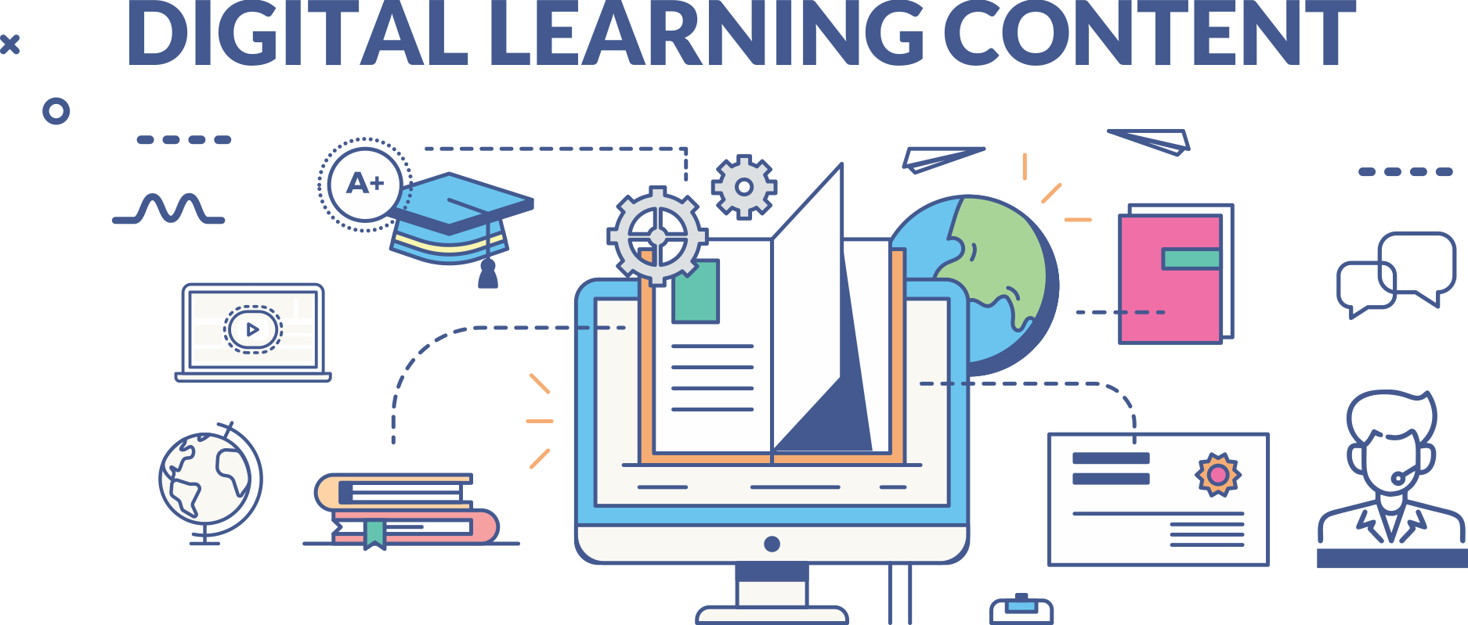

www.paruluniversity.ac.in

